Slide 1
Database DevOps
Section 4

Slide 2
4.1 – Best Practices

Slide 3
Best Practices for Development
Dark Launching
Adding objects to the database that aren’t used by the application
These changes don’t disturb the application
Users are unaware until we enable the feature
Database dark launching
New columns for tables/views
New parameters for stored procedures to change behavior

Slide 4
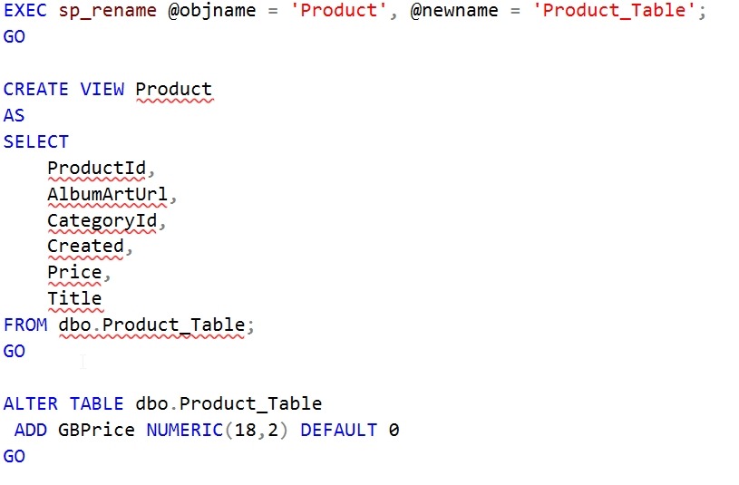
Dark Launching for tables

Slide 5
Use Views Carefully
Views can ease table schema changes
Be aware of insert/update/delete limitations
Avoid nesting views

Slide 6
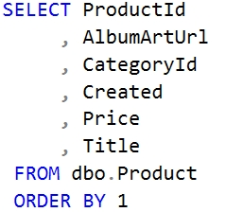
Best Practices for Development
Avoid depending on column order

Slide 7
Error Handling
Ensure database errors from schema changes are handled and reported to Dev and Ops.
May not want to surface these to users
Have graceful failback to previous functionality

Slide 8
Code Cleanup
Two types
Old objects
Old data
Limit technical debt
Use shared calendar reminders to schedule DROPs
Management support is helpful

Slide 9
4.2 – Branching and Merging

Slide 10
Branching
Each branch needs its own database
Data is the problem
New columns – where do I get data?
No column – what do I do with the data?
Provisioning new databases becomes important
You can use the same branch strategy as application code
May want to reuse, not delete branches
May rename databases if names matter
Keep these short lived.

Slide 11
Product table
Product table
ProductID | AlbumArtURL | CategoryID
1 | Placeholder.png | 1
2 | Placeholder.png | 5
ProductID | AlbumArtURL | CategoryID
1 | Placeholder.png | 1
2 | Placeholder.png | 5
ProductID | AlbumArtURL | CategoryID | Modified
1 | Placeholder.png | 1
2 | Placeholder.png | 5
Master branch
Feature branch

Slide 12
Merging
Merging changes can be merging code and data (if tracked)
SQL requires manual merges, but use tools
Kdiff3
CodeCompare
Beyond Compare
Etc.
Merge as often as you can (as you would with C#)
Beware squashing and deleting branches.
Merging back to the branch from master is better

Slide 13
4.3 – Provisioning

Slide 14
Provisioning Database Environments
Use Automation
PowerShell DSC
Chef
Puppet
All environments should be configured the same (in general)
Dev == QA == Staging == Production
Differences should be easily handled in automation tools
Builds Confidence
Databases are cattle
Any environment can be replaced

Slide 15
Provisioning Database Environments
Two Issues with data
Scale (data set size)
Sensitivity (PII, medical, financial, etc.)
Seeding data
Copying existing databases (backup/restore, snapshot, clone, etc.)
Using test data scripts
Speed
We don’t want developers waiting.
We want this easy so developers use this

Slide 16
4.4 – Monitoring

Slide 17
Monitoring Your Release
Monitoring provides feedback (one of the Three Ways)
Gather metrics on
Resources
Business counters
Object usage (essentially feature usage)
Ensure deployment timestamps are captured in your monitoring tool
Be sure dark launches are really dark
Be sure the feedback gets back to both Dev and Ops

Slide 18
4.5 – Disparate Environments

Slide 19
Dealing with Disparate Environments
Version upgrades
Same database schema at each version for all customers
Must provide a way to move from any version to the next
V1.0
V2.0
V2.1
V3.0

Slide 20
Dealing with Disparate Environments
Customer A
V2.1
V3.0
Customer B
V2.0
V3.0
Customer C
V1.0
V3.0

Slide 21
Dealing with Disparate Environments
Separate Databases
Any customer could have a separate schema
Must upgrade a portion of each database, potentially including the custom parts
Customers
Orders
OrdersDetail
GetCustomers
GetaDailySales
SalesCommissions
Customers
Orders
OrdersDetail
GetCustomers
GetMonthlySales
RunCEOReport
Customer A
Customer B

Slide 22

Shared Lookup Data
Custom Objects
Shared Objects
Custom Lookup Data

Slide 23
Dealing with Disparate Environments
Alex Yates, DLM Consultants offers guidance
Part 1 – Managing objects for different versions - https://www.red-gate.com/blog/database-lifecycle-management/how-to-build-multiple-database-versions-from-the-same-source-using-sql-compare-filters
Part 2 – Post-deploy scripts - http://www.red-gate.com/blog/database-lifecycle-management/post-deploy-scripts
Part 3 – Pre-deploy migration scripts - http://www.red-gate.com/blog/database-lifecycle-management/pre-deploy-migration-scripts

